Slide 1
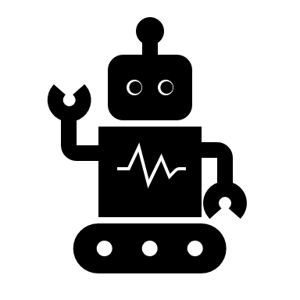
Robotics And Employment Is Correct
Khalil Ibrahim Alsulaimani 439007816
Mosab Mohammed albishi 439008089
Mohammed Ghazi Ahmed 439003899
Nawaf Ahmed Noor
439003406

Slide 2
introduction
In this presentation we will argue that certain tasks should not be fully dominated by robots for their lack of optical recognition requirements paired with lack of sensitive muscle control which robots lack against humans.
Robots have many advantages which we see in our everyday life from the speed of production of goods and technology to safety; however, everything has its limits and robots are no exception, so where do we draw the line and what aspects draw the line in the first place?
To draw the line, we must first understand the different aspects of both robots and humans

Slide 3
Human aspects
Adapting to new situations
Fine-tuned movement and control
Emotional Intelligence
Translation and Commination
Judgment

Slide 4
Robot aspects
Strength
Replicability
Autonomous

Slide 5
Where to draw the line
For ages human do their job where they do a demanding work but sometimes, they do not produce the amount that cover the price because the workers get tired after long work until robots where created which replaced the human work force in many industries as robots don’t get tired so they can work all day.
Because of that some jobs replace human workers with robot’s worker, and it is risen the benefit of the result, but the robot cannot do everything there is some job that robot can take part of it but can't replace the humans.
However, that doesn’t mean we have to replace all humans in all fields as we pointed out before the aspects that humans have are nonnegotiably in need of human employees for example :
Childcare Expert
Teacher
Doctor

Slide 6
solution
So, what should we do? How can we balance between the robot and human physical tasks? A set of practices in an article titled: "4 best practices to balance technology and the human touch" that were suggested by Fara Haron, CEO North America, Ireland, and Southeast Asia & EVP Global Clients, Majorel.; to achieve the perfect balance between robots and humans.
To achive that we could implement the following :
1. Adopt a hybrid model
2. Keep people in charge
3. Create a plan
4. Hire smart

Slide 7
conclusion
In conclusion, robots and humans have their own fields where each side excels and gets the best results however, we should learn from humans past mistakes of fearing new technology and instead we should embrace it and find new solutions such as hybrid methods and the other solutions mentioned above thus, we must put our egos aside and accept change but keep an open eye for new dangers or overuse of robots.

Slide 8

Thank you for listening

